Slide 1


PSM1 Video Presentation Link
FINAL YEAR PROJECT · PSM 1
SCHOOL OF COMPUTING (SECRH)
Design and Deployment of a Secure Cloud-Based Patient Data Management System Using a Three-Tier Architecture on AWS
Presented by
Mohamed Omar Makhlouf
Programme
BSc Computer Science (SECRH)
Supervisor
Mr. Johan Mohamed Sharif
Date
June 2026
Innovating Solutions
Notes:
Good morning panel members and supervisor. My name is Mohamed Omar Makhlouf, a final-year student in the School of Electrical, Computing and Engineering at Universiti Teknologi Malaysia, under the supervision of Mr. Johan Mohamed Sharif. Today I present the analysis and design of my PSM 1 project: Design and Deployment of a Secure Cloud-Based Patient Data Management System Using a Three-Tier Architecture on AWS. The project is motivated by a real ransomware incident at Alamin Clinic in May 2023. The presentation will take roughly ten minutes, after which I welcome your questions.

Slide 2

CHAPTER 1
Introduction
THE CLINIC
THE INCIDENT
Alamin Clinic (Saudi Arabia) operated a fully manual, server-based patient records system with shared credentials, no access control, no encryption, and no backup policy.
May 2023 — ransomware attack encrypted all patient data, halted operations for 5 days, caused permanent record loss, and made forensic investigation impossible.
THIS PROJECT PROPOSES
A secure, three-tier cloud-based patient data management system on AWS that eliminates the three structural gaps exposed by the ransomware attack — through layered RBAC, a full audit trail, and Terraform-driven recovery.
Secure AWS Patient Data System · PSM 1 Viva
02 / 14
Notes:
Alamin Clinic is a private clinic in Saudi Arabia running a fully manual, server-based patient records system. All staff share a single login, there is no access control, no data encryption, and no backup policy. In May 2023 a ransomware attack struck the clinic, encrypting every patient record and halting operations for five full days. Records were permanently lost and no forensic investigation was possible. This real-world incident exposed three structural security gaps that this project directly addresses: the absence of role-based access control, the absence of an audit trail, and the absence of any disaster recovery capability.

Slide 3
CHAPTER 1.2
Problem Statement
Three structural root-cause gaps identified from the Alamin Clinic ransomware case study:
P1
P2
P3
No Role-Based Access Control
No Audit Trail
No Disaster Recovery
Shared credentials allowed any staff member to access any patient record regardless of role. No data isolation between doctors, admin, and patients.
No logging of who accessed or modified records. Post-incident forensic investigation was completely impossible.
No backup, no infrastructure-as-code, no documented recovery plan. Full recovery took 5 days with permanent data loss.
HIGH IMPACT
HIGH IMPACT
CRITICAL
Source: Stakeholder interviews + Alamin Clinic post-mortem analysis
Secure AWS Patient Data System · PSM 1 Viva
03 / 14
Notes:
Three root-cause gaps were identified from the Alamin Clinic ransomware post-mortem. P1 is the absence of role-based access control: every staff member shared one login, so there was no data isolation between doctors, administrators, and patients — any user could read or modify any record. P2 is the absence of an audit trail: with no logging of who accessed or changed records, forensic investigation after the attack was entirely impossible. P3 is the absence of disaster recovery: no backup existed, no infrastructure-as-code could rebuild the environment, and the unplanned recovery took five days with permanent data loss. Each problem maps directly to a project objective and a non-functional requirement.

Slide 4
CHAPTER 1.3 – 1.4
Project Aim and Objectives
AIM
Design and deploy a secure, three-tier cloud-based patient data management system on AWS that directly eliminates all three critical gaps identified from the Alamin Clinic ransomware case study.
01
02
03
04
THREE-TIER VPC
3-LAYER RBAC
DEVSECOPS PIPELINE
RTO < 15 MIN
Isolated Public, Private App, and Private DB subnets on AWS.
JWT (app) · AWS IAM (infra) · PostgreSQL RLS (database)
SonarQube SAST · Trivy image scan · Checkov IaC · gates block on failure
Terraform IaC — full rebuild from clean state vs. 5-day recovery at Alamin Clinic.
Secure AWS Patient Data System · PSM 1 Viva
04 / 14
Notes:
The project aim is to design and deploy a secure, three-tier cloud-based patient data management system on AWS that directly eliminates all three gaps from the Alamin Clinic case. Four measurable objectives support this aim. First, design a three-tier AWS VPC with isolated public, private application, and private database subnets. Second, implement role-based access control enforced at three independent layers: JWT at the application layer, AWS IAM at the infrastructure layer, and PostgreSQL Row-Level Security at the database layer. Third, build a DevSecOps CI/CD pipeline with SonarQube SAST, Trivy container scanning, and Checkov IaC scanning — each configured to block deployment on failure. Fourth, achieve a ransomware recovery RTO under fifteen minutes using Terraform infrastructure-as-code, compared with the five-day recovery at Alamin Clinic.

Slide 5
CHAPTER 1.5
Project Scope
USER ROLES
TECHNOLOGY STACK
Role
Permissions
AWS ap-southeast-1 · Node.js / Express · React (S3 + CloudFront) · Amazon RDS PostgreSQL · Terraform
Doctor
View and create medical records for assigned patients only
Admin
Register patients, manage appointments, manage users (no clinical data)
PSM STAGES
PSM 1 — Analysis & Design · PSM 2 — Implementation & Testing
Patient
View own records and appointments — read-only
OUT OF SCOPE
Mobile app · Payment processing · Third-party EHR integration
Secure AWS Patient Data System · PSM 1 Viva
05 / 14
Notes:
The project scope is bounded by three user roles. Doctors can view and create medical records but only for patients assigned to them. Administrators can register patients, manage appointments, and manage user accounts but cannot see clinical data. Patients can view their own records and appointments in read-only mode. The system is deployed on AWS in the ap-southeast-1 Singapore region. The backend is Node.js and Express on EC2. The frontend is React, served via S3 and CloudFront. The database is Amazon RDS PostgreSQL with Multi-AZ. PSM 1 covers the analysis and design phase. PSM 2 will cover implementation and testing. Out of scope are a mobile application, payment processing, and third-party EHR integration.

Slide 6
CHAPTER 2
Literature Review and Existing Systems
Three healthcare systems compared against the proposed system across five critical dimensions.
Feature
OpenEMR
Epic Systems
AWS Well-Arch.
Proposed
RBAC
Basic
Enterprise
None (app)
3-layer
Audit Trail
✗
✓
API only
CloudTrail + DB
IaC / DR
✗
Proprietary
Partial
Terraform RTO <15 min
DevSecOps Pipeline
✗
✗
✗
6-stage automated
Open-source / SME fit
✓
✗
Partial
✓
Research Gap — No existing system combines 3-layer RBAC + a full DevSecOps pipeline + Terraform-based RTO < 15 min in a single cloud-native deployment for Malaysian healthcare.
Secure AWS Patient Data System · PSM 1 Viva
06 / 14
Notes:
Three existing systems were studied: OpenEMR, Epic Systems, and the AWS Well-Architected Healthcare framework. OpenEMR provides only basic RBAC, no audit trail, is on-premise only, and has no infrastructure-as-code or disaster recovery. Epic Systems offers enterprise-grade RBAC and audit logging but runs on a proprietary private cloud with proprietary disaster recovery — it is not open-source and is inaccessible to smaller healthcare providers. The AWS Well-Architected framework provides CloudTrail API logging and supports IaC partially, but it does not include application-layer RBAC. None of the three systems combines three-layer RBAC, a full DevSecOps CI/CD pipeline, and Terraform-based disaster recovery with an RTO under fifteen minutes in a single cloud-native open-source deployment. That is the research gap this project fills.

Slide 7
CHAPTER 3
Methodology
COMPLETED · PSM 1
PLANNED · PSM 2
1
2
3
4
5
Sprint 1
→
→
→
→
Sprint 2
Sprint 3
Sprint 4
Sprint 5
Requirements & Architecture · Stakeholder interviews · VPC blueprint
Network & DB Layer · VPC · RDS PostgreSQL · IAM
Application Layer · Node.js API · React · JWT auth
Security Integration · Pipeline · RLS · RBAC
Testing & Documentation · PSM 2 report · Viva
WHY AGILE + DEVSECOPS
REQUIREMENTS (PSM 1)
Security requirements evolved iteratively through 2 stakeholder interviews · security gates automated at every sprint.
12 Functional requirements · 11 Non-Functional requirements · 2 stakeholder interviews
Secure AWS Patient Data System · PSM 1 Viva
07 / 14
Notes:
Agile was chosen because security requirements evolved iteratively through two structured stakeholder interviews with the clinic's administrative staff and clinical staff. A waterfall approach would have locked requirements too early. DevSecOps is overlaid on the Agile sprints so security scanning is automated at every pipeline stage rather than being a single end-of-project gate. The five sprints cover requirements and architecture design in Sprint 1, which is complete at PSM 1. Sprints 2 through 5 — covering the network and database layer, application layer, security integration, and final testing — are planned for PSM 2 from June to November 2026.

Slide 8
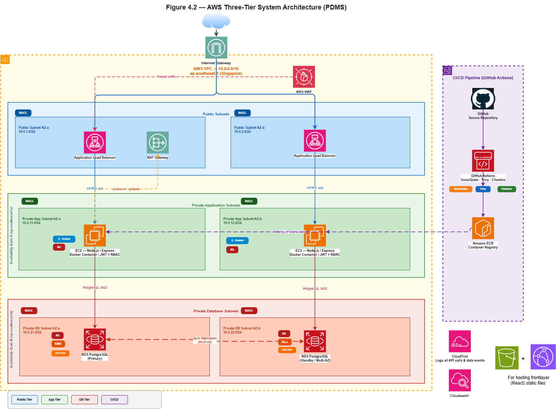
CHAPTER 4.3.1
System Architecture — Three-Tier AWS VPC
PUBLIC TIER
Application Load Balancer (HTTPS · port 443 only) NAT Gateway (private subnet outbound)
PRIVATE APPLICATION TIER
EC2 — Node.js / Express REST API S3 + CloudFront — React static frontend
PRIVATE DATABASE TIER
Amazon RDS PostgreSQL · Multi-AZ AES-256 encryption at rest · RLS active
CROSS-CUTTING SECURITY
Security Groups · Network ACLs · IAM least-privilege · CloudTrail · Terraform IaC
Secure AWS Patient Data System · PSM 1 Viva
08 / 14
Notes:
The proposed architecture is a three-tier AWS VPC. The public tier contains the Application Load Balancer, which accepts only HTTPS traffic on port 443, and the NAT Gateway which handles outbound traffic from the private subnets. The private application tier contains EC2 instances running the Node.js and Express REST API, and the React frontend served via S3 and CloudFront. The private database tier contains Amazon RDS PostgreSQL in a Multi-AZ deployment with AES-256 encryption at rest and row-level security policies active. Cross-cutting security controls include Security Groups, Network ACLs, AWS IAM least-privilege policies, CloudTrail for all API event logging, and Terraform managing the entire infrastructure as code. EC2 cannot reach RDS directly — all database access passes through the application layer and is further governed by row-level security.

Slide 9
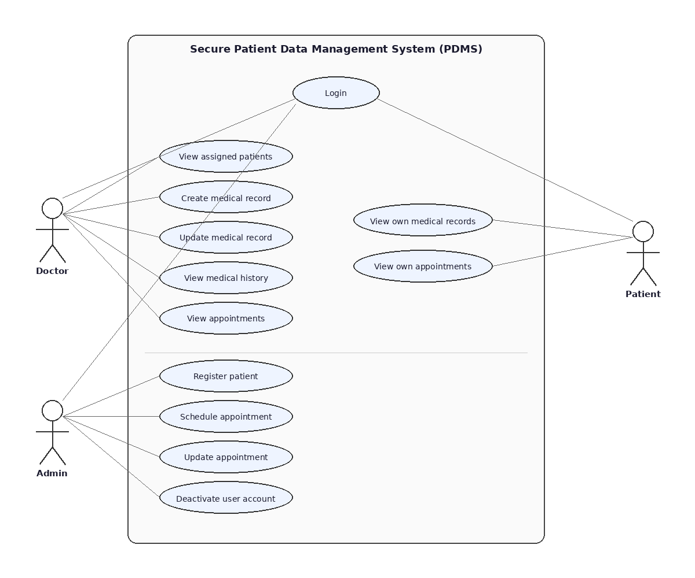
CHAPTER 4.3 – 4.4
System and Database Design
Use Case Diagram
3 actors · 18 use cases · 5 modules
DATABASE — 6 POSTGRESQL TABLES
users
patients
doctors
userId · UUID PK email · role passwordHash createdAt
patientId · UUID name · dob userId (FK) RLS active
doctorId · UUID userId (FK) specialisation assignedPatients
medical_records
appointments
audit_log
recordId · UUID patientId · doctorId diagnosis · notes RLS enforced
apptId · UUID patientId · doctorId datetime · status
logId · UUID userId · action table · timestamp INSERT ONLY
USE CASE SUMMARY
RLS rules — Doctors: own patients' records only · Patients: own profile only · audit_log: no UPDATE or DELETE
Doctor
View / create medical records (assigned patients only)
Admin
Register patients · appointments · user management
Patient
View own records and appointments (read-only)
Secure AWS Patient Data System · PSM 1 Viva
09 / 14
Notes:
The use case model contains 18 use cases across five modules: Authentication, Patient Management, Medical Records, Appointments, and Audit. Three actors are involved: Doctor, Admin, and Patient. The database design uses six PostgreSQL tables: users, patients, doctors, medical_records, appointments, and audit_log. All primary keys are UUIDs. Three key design decisions enforce security at the database layer. Row-level security on medical_records means a doctor can only see records for patients assigned to them. Row-level security on the patients table means each patient sees only their own profile. The audit_log table is insert-only — no update or delete operations are permitted, making it tamper-evident. These policies operate independently of the application code, so even if the application layer is bypassed, the database enforces the same access rules.

Slide 10
CHAPTER 4.2 · CHAPTER 4.5
Security Design and DevSecOps Pipeline
LAYER 1 — JWT (APP)
LAYER 2 — AWS IAM (INFRA)
LAYER 3 — POSTGRESQL RLS (DB)
httpOnly + Secure cookie
bcrypt cost factor 12
Role in token payload
SameSite=Strict
Least-privilege per service
EC2 cannot reach RDS directly
S3 blocks public access
Policies enforced by Terraform
Doctors: assigned records only
Patients: own profile only
Independent of application code
Bypass requires schema change
DEVSECOPS CI/CD PIPELINE — 6 STAGES
2 SonarQube SAST BLOCKS on CRITICAL
4 Trivy Image Scan BLOCKS on CRITICAL CVE
5 Checkov IaC Scan BLOCKS on HIGH/CRITICAL
6 Terraform Apply ONLY if all 3 pass
1 Code Checkout
→
→
3 Docker Build
→
→
→
HIPAA mapping: §164.312(a)(1) → 3-layer RBAC · §164.312(b) → CloudTrail + audit_log · §164.312(e)(2) → TLS + AES-256 · §164.312(a)(2)(ii) → Terraform RTO < 15 min
Secure AWS Patient Data System · PSM 1 Viva
10 / 14
Notes:
The security design has two major components. The three-layer RBAC model and the DevSecOps pipeline. For RBAC: Layer 1 is JWT at the application layer — tokens are stored in httpOnly and Secure cookies, roles are embedded in the token payload, bcrypt cost factor 12 is used for password hashing, and SameSite Strict prevents cross-site request forgery. Layer 2 is AWS IAM at the infrastructure layer — least-privilege policies per service, EC2 cannot reach RDS directly, S3 blocks all public access, and all policies are managed by Terraform. Layer 3 is PostgreSQL Row-Level Security at the database layer — doctors see only their assigned records, patients see only their own profile, and this enforcement is completely independent of the application code. The DevSecOps pipeline has six stages: code checkout, SonarQube SAST which blocks on any critical finding, Docker build, Trivy image scan which blocks on critical CVEs, Checkov IaC scan which blocks on high or critical findings, and finally Terraform apply which only runs if all three security gates pass. HIPAA compliance mapping confirms this design covers sections 164.312 a, b, and e.

Slide 11
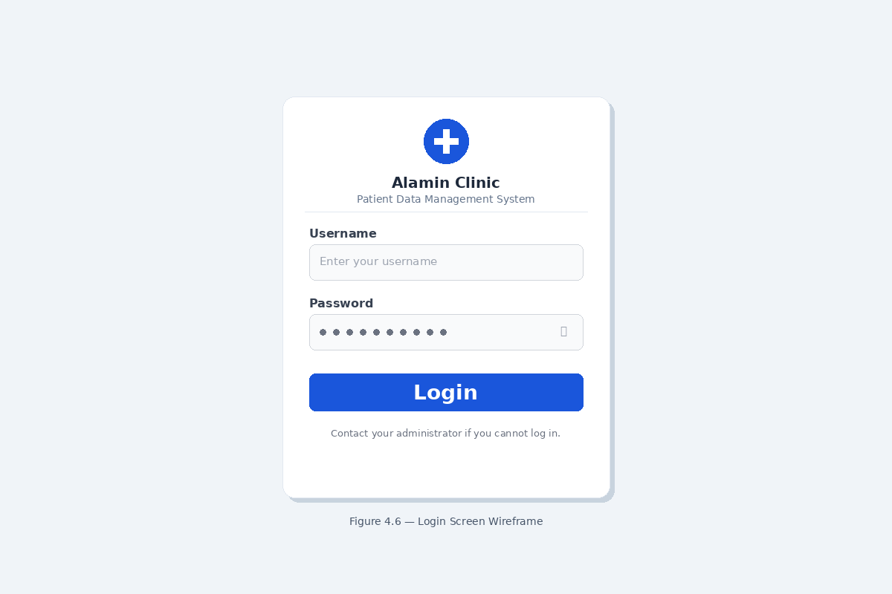
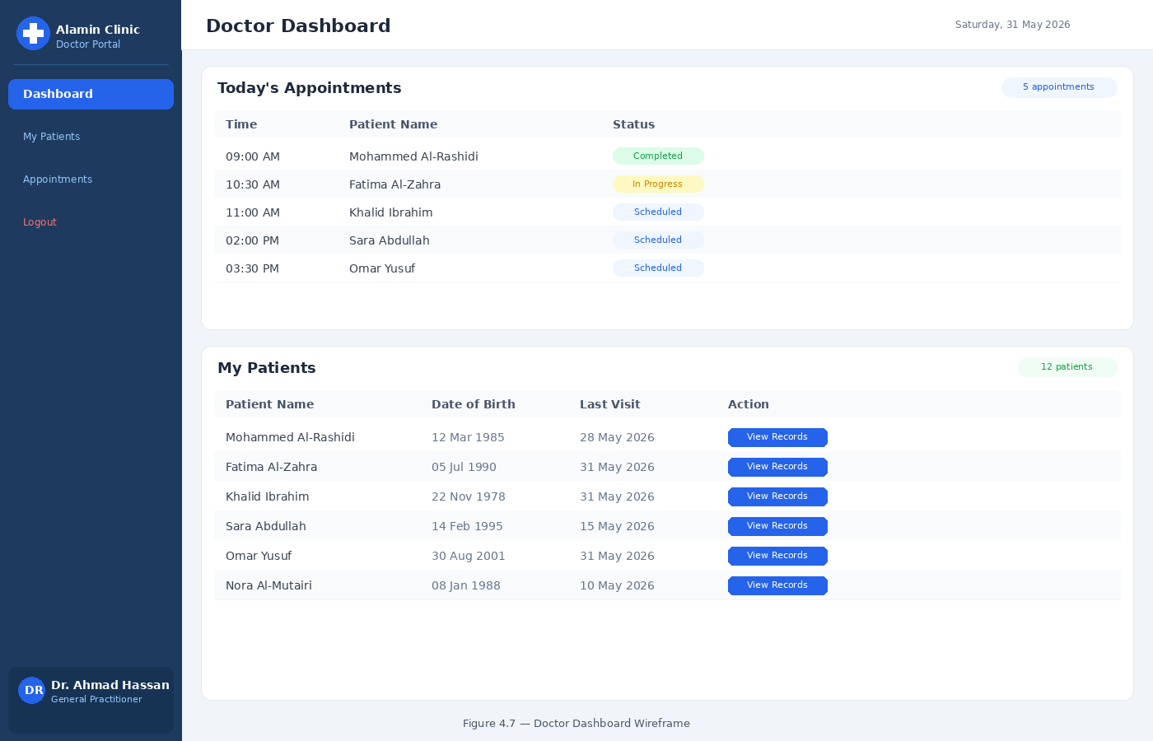
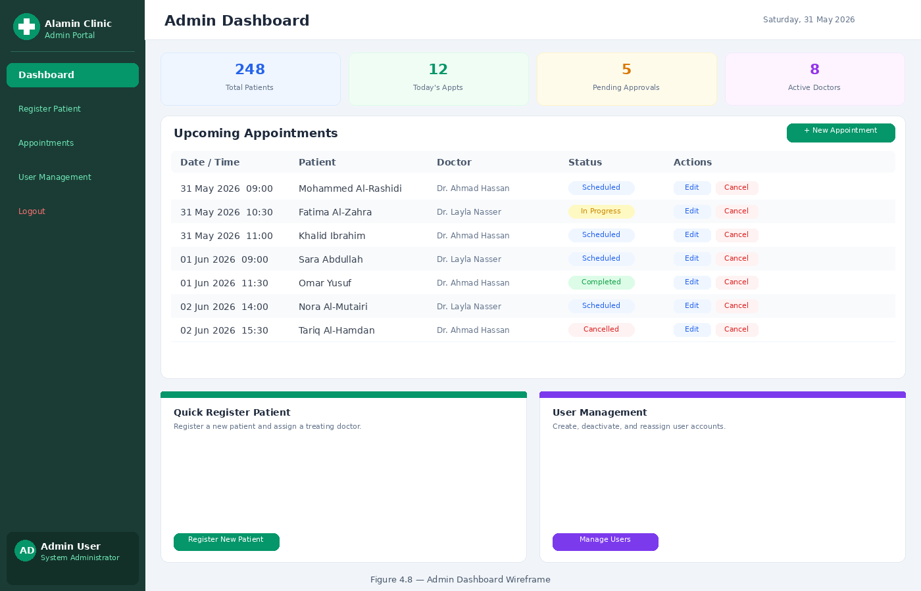
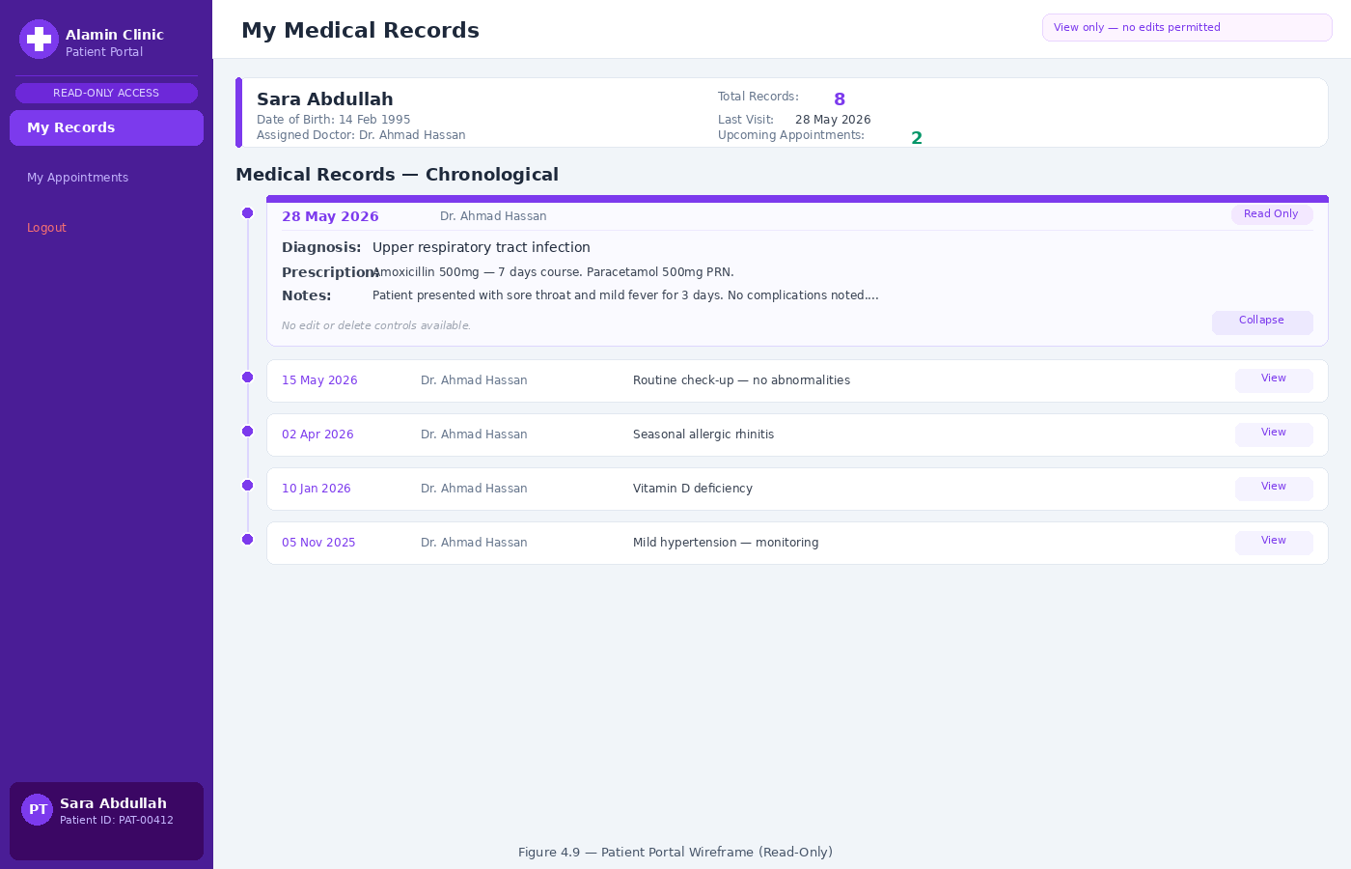
APPENDIX E
Interface Wireframes — Role-Based Design
Fig E.1 — Login
Fig E.2 — Doctor Dashboard
Fig E.3 — Admin Dashboard
Fig E.4 — Patient Portal
Single entry for all 3 roles
JWT redirects to role dashboard
No self-registration
My Patients + Appointments
New Record — assigned only
No admin functions visible
Register Patient · Appointments
User Management
No clinical data visible
My Records (read-only)
My Appointments
No edit or delete controls
Key principle: role isolation is enforced visually — each screen surfaces only what that role is permitted to access.
Secure AWS Patient Data System · PSM 1 Viva
11 / 14
Notes:
Four role-based wireframes were designed in Appendix E. Figure E.1 is the Login Screen — a single entry point for all three roles. After authentication, the JWT redirects each user to their own role-specific dashboard. There is no self-registration. Figure E.2 is the Doctor Dashboard — a left sidebar shows Patients and Appointments. Doctors can only create new records for their assigned patients, and no administrative functions are visible. Figure E.3 is the Admin Dashboard — the admin can register patients, manage appointments, and manage user accounts, but no clinical data is visible at all. Figure E.4 is the Patient Portal — patients can view their own records and appointments in read-only mode, with no edit or delete controls rendered on screen. The core principle across all four screens is that role isolation is enforced visually — each interface only surfaces what that role is permitted to access.

Slide 12
CHAPTER 4.9
Evaluation Plan
01
02
03
04
05
Functional Testing
Security Testing
Pipeline Testing
Recovery Testing
Compliance Audit
Test cases for all 18 use cases · positive and negative scenarios · covers all 12 FRs
Penetration testing to validate 3-layer RBAC · confirm RLS cannot be bypassed from app layer
Confirm each security gate blocks on CRITICAL · confirm Terraform apply only runs on full pass
Destroy test environment → terraform apply → measure RTO · Target: < 15 minutes
HIPAA §164.312 compliance validation · Malaysia PDPA 2010 review
All evaluation activities planned for PSM 2 — the system has not yet been implemented.
Secure AWS Patient Data System · PSM 1 Viva
12 / 14
Notes:
The evaluation plan has five layers, all to be executed in PSM 2. Functional testing will cover test cases for all 18 use cases with both positive and negative scenarios. Security testing will include penetration testing to validate each RBAC layer and confirm the RLS policies cannot be bypassed. Pipeline testing will verify that each security gate correctly blocks deployment when a critical or high-severity finding is present. Recovery testing will destroy the test environment and measure the time taken for terraform apply to restore it to a fully operational state — the target is under fifteen minutes. Compliance auditing will validate the design against HIPAA section 164.312 and Malaysia's Personal Data Protection Act 2010.

Slide 13
CHAPTER 5
PSM 1 Achievements and PSM 2 Plan
PSM 1
Completed
PSM 2
Planned · June–November 2026
✓
Ransomware root cause analysis (Alamin Clinic)
→
VPC + RDS + IAM deployment via Terraform
✓
2 stakeholder interviews conducted
→
Node.js / Express backend + React frontend
✓
18 use cases · 12 FR · 11 NFR
→
JWT authentication + PostgreSQL RLS activation
✓
Three-tier AWS VPC architecture designed
→
DevSecOps pipeline activation and testing
✓
3-layer RBAC model defined (JWT + IAM + RLS)
→
Penetration testing + formal security audit
✓
6-stage DevSecOps pipeline designed
→
PDPA 2010 compliance review
✓
Database schema + RLS policies (6 tables)
→
PSM 2 documentation + viva
✓
4 role-based wireframes (Appendix E)
✓
HIPAA §164.312 compliance mapping
Secure AWS Patient Data System · PSM 1 Viva
13 / 14
Notes:
PSM 1 has produced a comprehensive set of design artefacts. These include the Alamin Clinic ransomware root cause analysis, two stakeholder interviews, 18 use cases and twelve functional plus eleven non-functional requirements, the three-tier AWS VPC architecture design, the three-layer RBAC model, the six-stage DevSecOps pipeline design, the database schema with six tables and row-level security policies, four role-based interface wireframes in Appendix E, and a HIPAA section 164.312 compliance mapping. PSM 2, running from June to November 2026, will implement all of this: Terraform-provisioned VPC, RDS, and IAM; the Node.js and React application; JWT authentication and PostgreSQL RLS activation; the full DevSecOps pipeline; penetration testing and a formal security audit; PDPA 2010 compliance review; and the final documentation and viva.

Slide 14
PSM 1 VIVA · 2026
QUESTIONS & DISCUSSION
Thank You.
Project
Secure Cloud-Based Patient Data Management System — Three-Tier Architecture on AWS
Presenter
Mohamed Omar Makhlouf
Supervisor
Mr. Johan Mohamed Sharif
Faculty
SECRH · Universiti Teknologi Malaysia, Johor Bahru
Innovating Solutions
14 / 14
Notes:
Thank you very much for your time and attention. I would welcome any questions on the system architecture, the security design, the database schema, the DevSecOps pipeline, or the evaluation plan.

